Slide 1
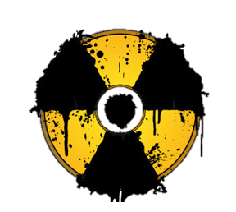

Briefing on radiation exposure:
Definitions, categories and threats
Médecins Sans Frontières
EMACC and CBRN intersection WGs
With acknowledgements to Jean-Baptiste, Jèrôme Leglise, Claire Contargyris
With the support of the Institut de Radioprotection et de Sûreté Nucléaire (IRSN), France
EN_2022_MSF_Briiefing_on_nuclear_accidents_V2022-04. Validated by C. Rieux, OCP DirMed , and
by the MSF EMACC Working Group for intersectional use.

Slide 2
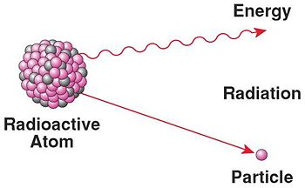
Basic principles of radiation physics
I got to evacuate energy !
I’m transforming !
What is radiation?
Radioactive atom :
excess of internal energy.
Electro-magnetic waves
Radiation :
A process in which atomic particles or waves of energy travel through a material medium or space.
Radiation
Ionizing Radiation :
Can free an electron from an atom or molecule
Harmful
Can alter cells and DNA
Notes:
A radio active atom Is an unstable atom, usually because it has an excess of energy, it will release energy in the form of particles (matter) or elecromagnaetic waves. That’s radiation.
Radiation is a process through which atomic particles or waves of energy –electromagnetic waves) in our case released by a radioactive atom, travel through a materiela medium or space…
There are two categories of radiation: ionizing and non-ionizing.
In common usage, radiation refers to ionizing radiation, that is, energy in the form of atomic or subatomic particles, or electromagnetic waves that is sufficient to free an electron from an atom or molecule, causing it to become ionized.
Both ionizing and non-ionizing radiation can be harmful to living organisms. In general, ionizing radiation is more harmful to living organisms than non-ionizing radiation deposited per unit of energy, as the ions produced have the potential to cause chemical changes in cells and DNA damage.

Slide 3
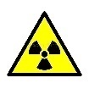
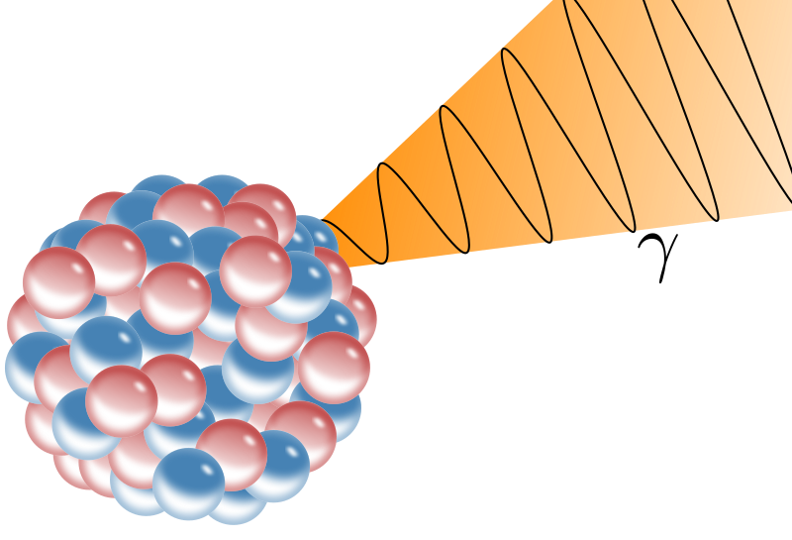
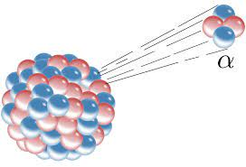


Types of ionizing radiation
Main types of ionizing radiation
Particles
Electromagnetic Waves
Alpha radiation
Gama radiation
Only penetrates a few centimeters of air or a few millimeters of low-density material.
Penetrates much further
through matter.
Stopped by a wall/panel of lead or concrete.
Gamma radiation frequently accompanies the emission of alpha and beta radiation during a radioactive accident.
The FIRST TO BE DETECTED
Alpha particles do not penetrate the skin and cause no damage to tissues below.
Beta radiation
Few meters in the air.
Stopped by a wall made of wood, glass or aluminum.
Clothing provides some protection against beta radiation.
Notes:
Several types of radiation might be released during a nuclear accident. We are going to talk about the main ones
Some ionizing radiations are made of particles, that interact with matter, and are diffused with the wind attached to dust…
Alpha and Beta radiation are composed of ionized particles
Alpha (2protons and 2 neutrons) are the most ionized particles, therefore have more interactions with materials.
Alpha particles not penetrate the skin and cause no damage to tissues below.
Beta (electrons)
Particles that can travel few meters in the air.
Can be stopped by a wall made of wood, glass or aluminum.
Clothing provides some protection against beta radiation.
Gamma radiation, composed of photons penetrates much further through matter.
Frequently accompanies the emission of alpha and beta radiation during radioactive accident and as such are the one firstly detected

Slide 4
Types of ionizing radiation
Main types of ionizing radiation
Particles
Electromagnetic Waves
Alpha radiation
Gama radiation
Only penetrates a few centimeters of air or a few millimeters of low-density material.
Penetrates much further
through matter.
Stopped by a wall/panel of lead or concrete.
Gamma radiation frequently accompanies the emission of alpha and beta radiation during a radioactive accident.
The FIRST TO BE DETECTED
Alpha particles do not penetrate the skin and cause no damage to tissues below.
Beta radiation
Few meters in the air.
Stopped by a wall made of wood, glass or aluminum.
Clothing provides some protection against beta radiation.
Notes:
Several types of radiation might be released during a nuclear accident. We are going to talk about the main ones
Some ionizing radiations are made of particles, that interact with matter, and are diffused with the wind attached to dust…
Alpha and Beta radiation are composed of ionized particles
Alpha (2protons and 2 neutrons) are the most ionized particles, therefore have more interactions with materials.
Alpha particles not penetrate the skin and cause no damage to tissues below.
Beta (electrons)
Particles that can travel few meters in the air.
Can be stopped by a wall made of wood, glass or aluminum.
Clothing provides some protection against beta radiation.
Gamma radiation, composed of photons penetrates much further through matter.
Frequently accompanies the emission of alpha and beta radiation during radioactive accident and as such are the one firstly detected

Slide 5



Units and tools for the measurement of radiation
Measuring Radiation
SIMPSONS GUIDE TO RADIATION
Radioactivity
Amount of ionizing radiation released by a material. How bright does your Cesium glow
Bequerels (Bq)
Absorbed dose
Amount of radiation absorbed by an object or person. How bright will Cesium make you glow
Gray (Gy)
Dose equivalent
combines the amount of radiation absorbed and the medical effects of that type of radiation.
Sieverts (Sv)
0,1µSv/h Normal
radiation
Notes:
There different but interrelated units for measuring radioactivity, absorbed dose, and dose equivalent..
Sievert is the most used unit, either as dose ( Sv), dose rate (Sv/h) or accumulated dose (Sv/year)
Normal radiation in the environment is arround 0,1µSv/h
50 mSv/year is considered, conservatively, as the lowest dose at which there is any evidence of cancer being caused in adults.

Slide 6
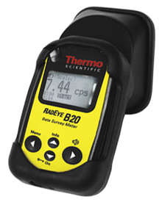
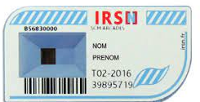
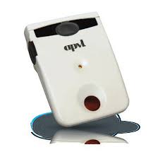
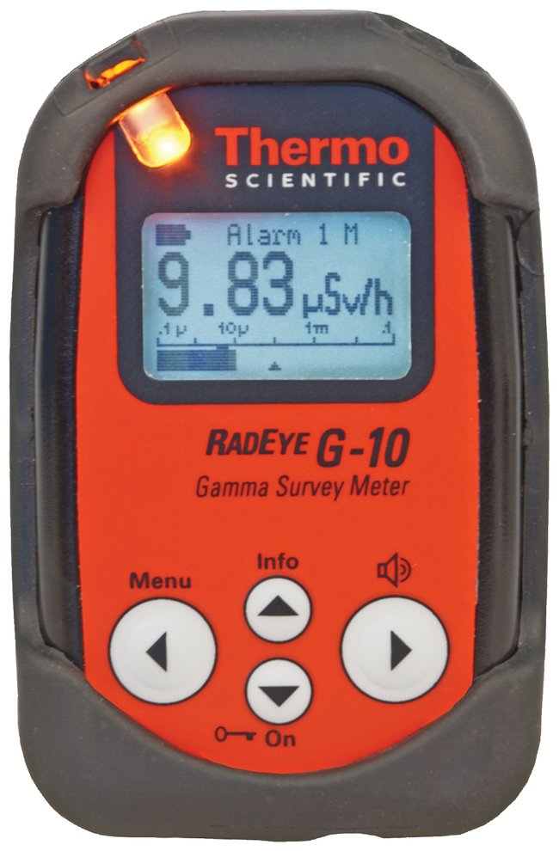
Units and tools for the measurement of radiation
Measuring Radiation
Personal dosimeter
Kept at all time secured on the chest.
Gamma and x ray energy absorbed (doses) over a given period by human body. Analyzed at the end of mission
Do not remove plastic from dosimeter as it affects function.
Contamination detector
Alpha and beta particles (clothes, ground, etc.) +/- gamma and x-ray radiation.
Radiometer
Gamma and x ray present in the surrounding area.
1st alarm at 25µSv/h and 2nd alarm at 100 µSv/h
Operational Dosimeter
Notes:
You will be handed out detetion material on the field. Detection equipment is an important component of ensuring the team members’ immediately safety during a nuclear emergency as well as anticipating any long-term health effects of exposure to radioactivity.
Personal dosimeter
Passive dosimeter, kept at all time secured on the chest.
Gamma and x ray energy absorbed (doses) over a given period by human body.
Analyzed at the end of mission by the Institute of Radioprotection and Nuclear Safety (IRSN) in France.
One dosimeter should be kept inside the shelter for comparison of dose accumulated.
Do not remove plastic from dosimeter as it affects function.
Radiometer :
The RadEyeTM G10 Geiger–Müller counters, portable and robust hand carrying device.
During a confinement phase, if the shelter has a window, place the radiometer close to it.
Contaminometer :
Alpha and beta particles (clothes, ground, etc.) and according to the device detect gamma and x-ray radiation.
The RadEyeTM B20 used by MSF can detect low level of alpha and beta particles,
Set with two alarms 1st alarm at 25µSv/h and 2nd alarm at 100 µSv/h and enhance direct measure precaution with the surface or a contaminated person (e.g., decontamination procedures).
Operational dosimeter
A self-reading and electronic dosimeter that will be switched on and kept inside the shelter in case of an alert in order to know cumulative doses of the group present in the room.
adio

Slide 7
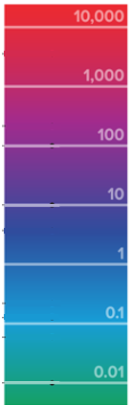
Units and tools for the measurement of radiation
Effects of Radiation
10 000 mSv : Fatal within days
6 000 mSv : Dose received by Tchernobyl workers who died in a month.
5 000 mSv : 50% die within a month
2 000 mSv : Potentially lethal radiation
- HIGH risk of cancer later in life
- Acute Radiation Sickness (Nausea, vomiting, diarhea, headache within min to days after exposure. Can last min to days. Come and go.)
1 000 mSv : 5% Higher risk of cancer
400 mSv : Highest hourly dose recorded in Fukushima
100 mSv : level at which higher risk of cancer is first noticeable
2 mSv : Average yearly backround

Slide 8
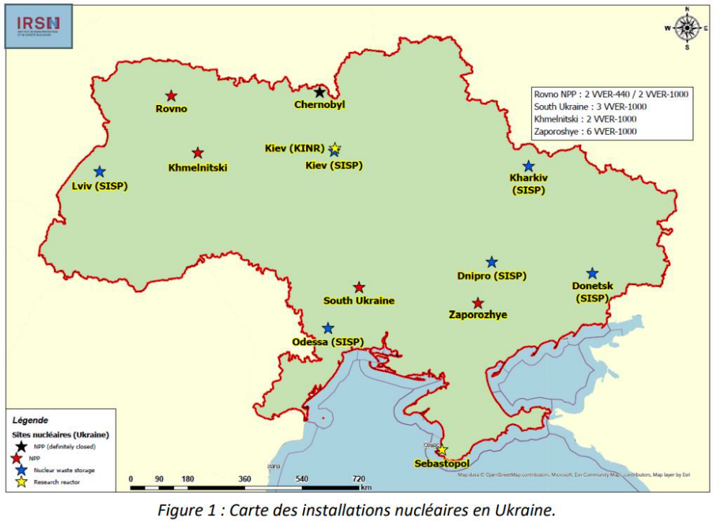
Threat posed by nuclear power reactors
In Ukraine:
15 nuclear reactors
6 nuclear waste storage facilities
2 nuclear research reactors
Rupture of electrical supply to reactor cooling systems and a lack of fuel to power back-up electrical generators..
Direct damage from shelling or bombardment
Notes:
Principal threat for a nuclear accident during the current conflict is a rupture of electrical supply to reactor cooling systems and a lack of fuel to power back-up electrical generators. The inability to power these critical systems would cause temperatures to rise in the core that could breach the integrity of containment walls, causing a “meltdown” and subsequent release of radioactive material.
Direct damage from shelling or bombardment is another concern given the “near miss” from a missile attack near the Zaporozhye facility, Europe’s largest nuclear power plant.

Slide 9
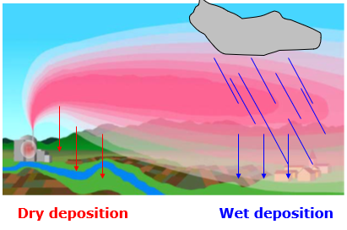
Spread of radioactive contamination
How does radioactive contamination spread following a nuclear accident?
Releases can last from a few hours to several days depending on the type of accident.
Deposit on surfaces,
Deposition is not only a matter of distance,
"radioactive deposition spots”
Notes:
Following a major nuclear accident, the release of a large amount of radioactivity into the environment is the critical risk for contamination
If a nuclear reactor is damage it might take hours to days befores release of radioactivity
Deposit on surfaces, whether natural or cultivated areas, as well as built-up areas or your clothes
Deposition is not only a matter of distance, depends on the topography of the area, the wind and where rainfall occurred.
It can then form the "radioactive deposition spots," even at some distance from the site.

Slide 10
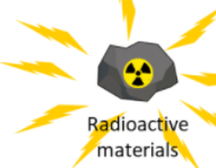


Spread of radioactive contamination
Routes of exposure
Internal exposure = radioactive materials that enter the human body by inhalation, ingestion or to a lesser extent via injury.
External exposure = when the source of radiation is external to the human body.
External Irradiation
Internal contamination, even by low energy radioactive sources is dangerous because it will fix in internal organs and expose them to irradiation for a long period of time.
External contamination
Radioactive dust, falling form nuclear plume, deposited on
skin or clothes. Source of external radiation.
External contamination becomes dangerous if inhaled or ingested thus when it becomes internal contamination…
Notes:
External exposure = when the source of radiation (radioactive object, "cloud" of radioactivity in the air, deposits on soils, built surfaces, etc.) is external to the human body.
Dangerous if highly concentrated (near the nuclear incident). Rapidly very less dangerous if you are far from the incident (a few km). Not dangerous because non existent once you have decontaminated.
Reduce exposure by moving away from the source of radioactivity, or by reducing the time spent nearby or by interposing barriers of high density between the source and the exposed person.
Staying inside a solid building whose interior is not contaminated will thus provide protection against external irradiation outside.
However, when the irradiation due to the contamination of the external environment is too significant, the temporary or permanent evacuation of the affected area is preferable.
Internal contamination
To reduce this exposure, shelter inside an enclosed building during the passage of the radioactive plume through the air,
or use protective equipment that filters the breathed air (FFP3 mask sufficient).
Consume only canned food and water free of contamination.
Do not to bring your hands to your mouth (eating, smoking).
Clean hands save lives.

Slide 11
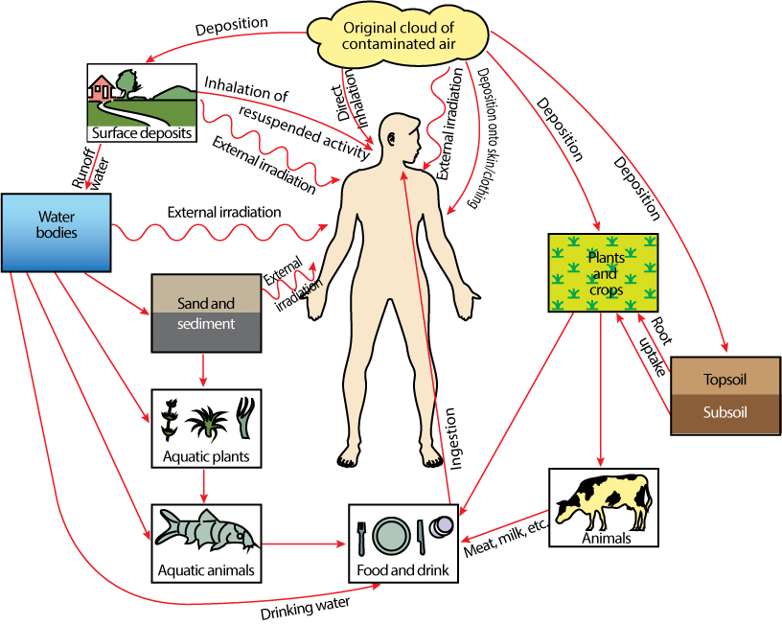

Spread of radioactive contamination
Environmental pathways of exposure to nuclear accidents

Slide 12
Thank you

